Slide 1


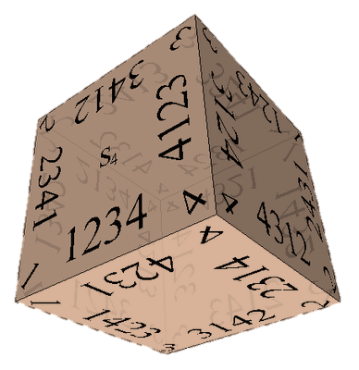

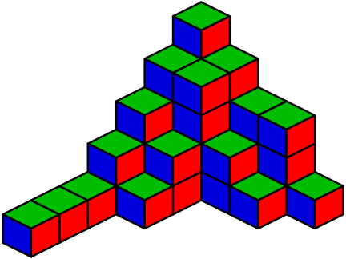

Combinatorial Algorithms
Generating Permutations, Variations, Combinations, …
Combinatorial Algorithms
SoftUni Team
Technical Trainers
Software University
http://softuni.bg
Notes:
© Software University Foundation – http://softuni.org
This work is licensed under the Creative Commons Attribution-NonCommercial-ShareAlike license.
<number>

Slide 2
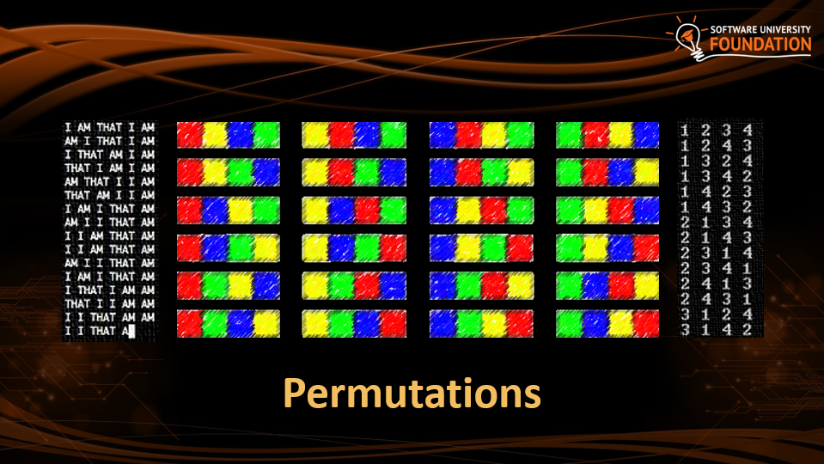

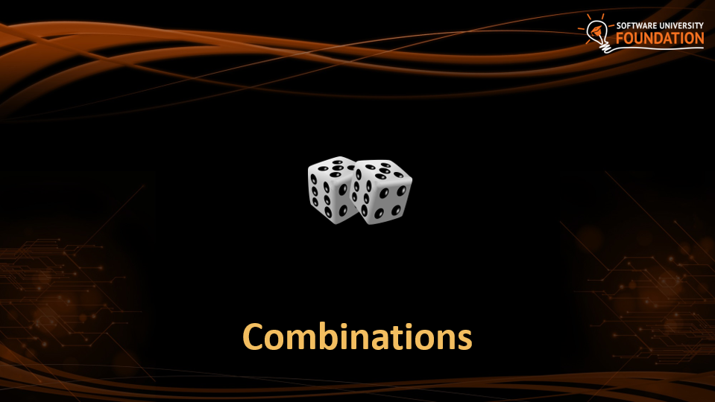
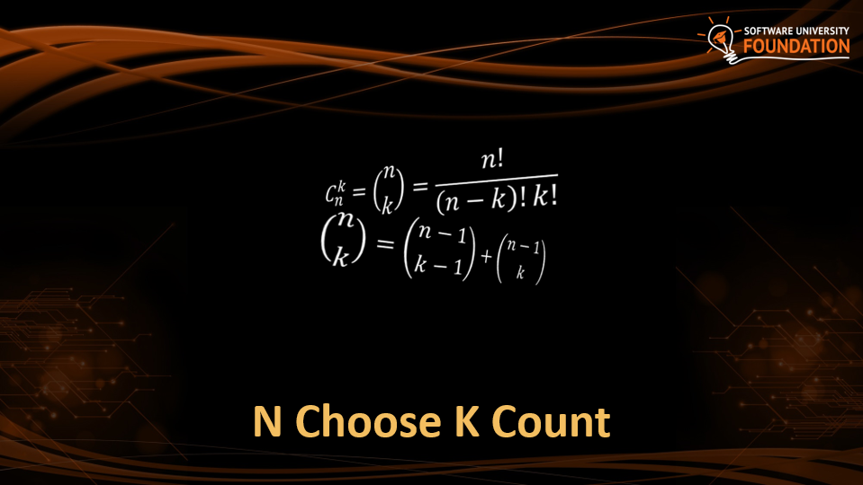
Table of Contents
<number>
Notes:
© Software University Foundation – http://softuni.org
This work is licensed under the Creative Commons Attribution-NonCommercial-ShareAlike license.
<number>

Slide 3
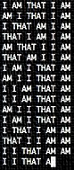
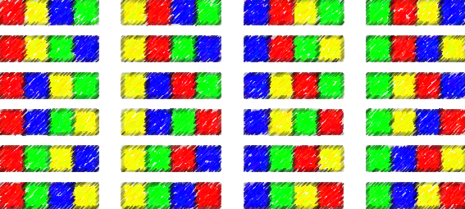
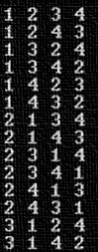
Permutations

Slide 4

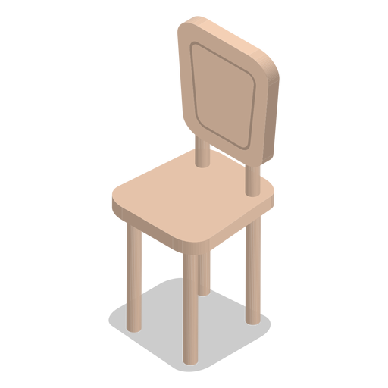


Permutations
How to order them in three chairs
<number>

Slide 5
Permutations
How to order them in two chairs
<number>

Slide 6
Permutations
How to order him in one chairs
<number>

Slide 7
Permutations
<number>

Slide 8
Permutations
Order A, B and C in all possible ways
A
B
C
<number>

Slide 9
Permutations
Order A, B and C in all possible ways
A
B
C
A | B
A | C
B | A
B | C
C | A
C | B
<number>

Slide 10
Permutations
Order A, B and C in all possible ways
A
B
C
A | B
A | C
B | A
B | C
C | A
C | B
A | B | C
A | C | B
B | A | C
B | C | A
C | A | B
C | B | A
<number>

Slide 11
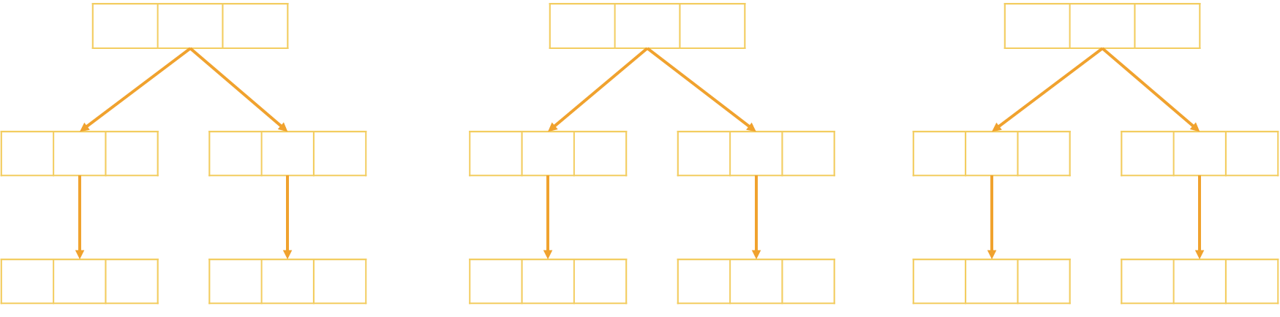
Problem: Generate Permutations
Generates all possible permutations of a given set of elements
You can pick each item only once
A B C
A C B
B A C
B C A
C A B C B A
A B C
<number>

Slide 12
Algorithm: Permutations
Algorithm Permute(index) to generate variations P(n)
Put unused elements 0 … n-1 at position index
Mark/unmark elements as being used
Call Permute(index + 1)
Permute(0)
Permute(1)
Permute(k)
Print();
Stop!
0…n-1 | x | x | x | x
→
y | 0…n-1 | x | x | x
…
(unused)
(unused)
Permute(1)
Permute(2)
<number>

Slide 13
Generating Permutations
public static void Gen(int index)
{
if (index >= elements.Length)
Console.WriteLine(string.Join(" ", perm));
else
for (int i = 0; i < elements.Length; i++)
if (!used[i])
{
used[i] = true;
perm[index] = elements[i];
Gen(index + 1);
used[i] = false;
}
}
elements = new int[n];
used = new bool[n];
Permute(0);
<number>

Slide 14
Permutations Count
Order A, B and C in all possible ways
How many ways are there?
A | B | C
3
2
1
n! = 3!
6 possible ways
<number>

Slide 15
Problem: Optimize Permutations
Generates all possible permutations of a given set of elements
Without using extra memory
A B C
A C B
B A C
B C A
C A B C B A
A B C
<number>

Slide 16
Permutations: Swap Algorithm
<number>

Slide 17
Permutations: Swap Algorithm
<number>

Slide 18
Permutations: Swap Algorithm
<number>

Slide 19



Permutations: Swap Algorithm
<number>

Slide 20
Permutations: Swap Algorithm
<number>

Slide 21
Permutations: Swap Algorithm
Swap to origin on the way back
<number>

Slide 22
Permutations: Swap Algorithm
<number>

Slide 23
Permutations: Swap Algorithm
<number>

Slide 24
Permutations: Swap Algorithm
Swap to origin on the way back
<number>

Slide 25
Permutations: Swap Algorithm
Swap to origin on the way back
<number>

Slide 26
Permutations: Swap Algorithm
<number>

Slide 27
Permutations: Swap Algorithm
<number>

Slide 28
Permutations: Swap Algorithm
<number>

Slide 29
Permutations: Swap Algorithm
<number>

Slide 30
Problem: Optimize Permutations
Generates all possible permutations of a given set of elements
Without using extra memory
A B C
A C B
B A C
B C A
C A B C B A
A B C
<number>

Slide 31
Generating Permutations
public static void Gen(int index)
if (index >= set.Length)
Console.WriteLine(string.Join(" ", set));
else
Gen(index + 1);
for (int i = index + 1; i < elements.Length; i++)
{
Swap(index, i);
Gen(index + 1);
Swap(index, i);
}
}
elements = new int[n];
Permute(0);
<number>

Slide 32
Problem: Permutations with Repetition
What about array = new int[] { A, B, B }
By definition: permutations { A, B', B'' } == { A, B'', B' }
Generate all permutations from a multi-set
A B B
B A B
B B A
A B B
<number>

Slide 33
Solution: Permutations with Repetition
public static void Gen(int index)
if (index >= set.Length)
Console.WriteLine(string.Join(" ", set));
else
HashSet<int> swapped = new HashSet<int>();
for (int i = index; i < elements.Length; i++) {
If (!swapped.Contains(elements[i])) {
Swap(index, i);
Gen(index + 1);
Swap(index, i);
swapped.Add(elements[i]);
}
}
}
elements = new int[n];
Permute(0);
<number>

Slide 34
Optimized: Permutations with Repetition
Algorithm PermRep(s, e) permutes the items [s … e]
Exchange the item at positions l = k … n-2 with items at l … n-1
Call PermRep(l + 1) to permute the rest of the array
PermRep(0, n-1)
PermRep(2, n-1)
PermRep(n-1, n-1)
s
l
s
l
Stop!
→
…
y | x | l | x | x | x
z | y | x | l | x | x
PermRep(l+1, n-1)
PermRep(l+1, n-1)
More info: http://hardprogrammer.blogspot.bg/2006/11/permutaciones-con-repeticin.html
<number>

Slide 35
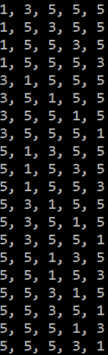
Generating Permutations with Repetition
static void PermuteRep(int[] arr, int start, int end)
{
Print(arr);
for (int left = end - 1; left >= start; left--)
{
for (int right = left + 1; right <= end; right++)
if (arr[left] != arr[right])
{
Swap(ref arr[left], ref arr[right]);
PermuteRep(arr, left + 1, end);
}
var firstElement = arr[left];
for (int i = left; i <= end - 1; i++)
arr[i] = arr[i + 1];
arr[end] = firstElement;
}
}
var arr = new int[] {3, 5, 1, 5, 5};
Array.Sort(arr);
PermuteRep(arr, 0, arr.Length-1);
<number>

Slide 36

Permutations with Repetition Count
Order A, B and B in all possible ways
How many ways are there?
A | B | B
=
3 different ways
<number>

Slide 37

Permutations
Live Exercises in Class (Lab)

Slide 38
Variations

Slide 39



Variations
Not enough chairs
<number>

Slide 40
Variations
<number>

Slide 41


Variations
<number>

Slide 42

Variations
<number>

Slide 43
Variations
<number>

Slide 44
Variations
<number>

Slide 45
Variations
<number>

Slide 46
Variations
<number>

Slide 47
Variations
<number>

Slide 48
Variations
<number>

Slide 49
Variations
Order A, B and C in all possible ways int k slots
Pick each item only once
A
B
C
<number>

Slide 50
Variations
Order A, B and C in all possible ways int k slots
Pick each item only once
A
B
C
A | B
A | C
B | A
B | C
C | A
C | B
<number>

Slide 51
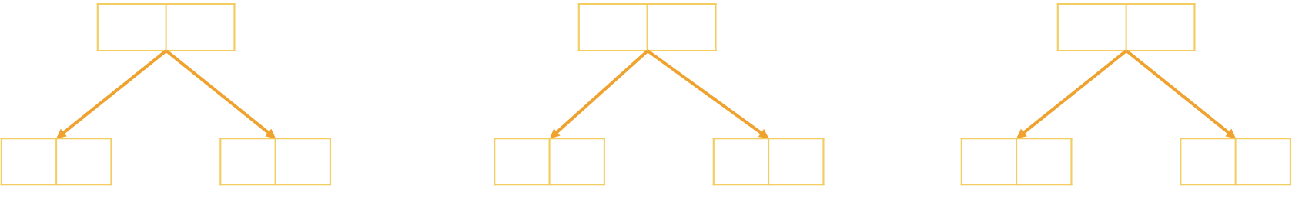
Problem: Generate Variations
Generates all possible variations of k from a set of elements
You can pick an item once
A B
A C
B A
B C
C A
C B
A B C
2
<number>

Slide 52
Generating Variations
public static void Gen(int index)
{
if (index >= k)
Console.WriteLine(string.Join(" ", vari));
else
for (int i = 0; i < elements.Length; i++)
if (!used[i])
{
used[i] = true;
vari[index] = elements[i];
Gen(index + 1);
used[i] = false;
}
}
elements = new int[n];
vari = new int[k]
used = new bool[n];
Permute(0);
<number>

Slide 53

Variations Count
Order two from A, B, C and D in all possible ways
How many ways are there?
A | B | C | D
4
3
Multiply
=
12 different ways
<number>

Slide 54
Variations with Repetitions
Order A, B and C in all possible ways into k slots
You can pick an item multiple times
A
B
C
A | A
A | B
B | A
B | B
C | A
C | B
A | C
B | C
C | C
<number>

Slide 55
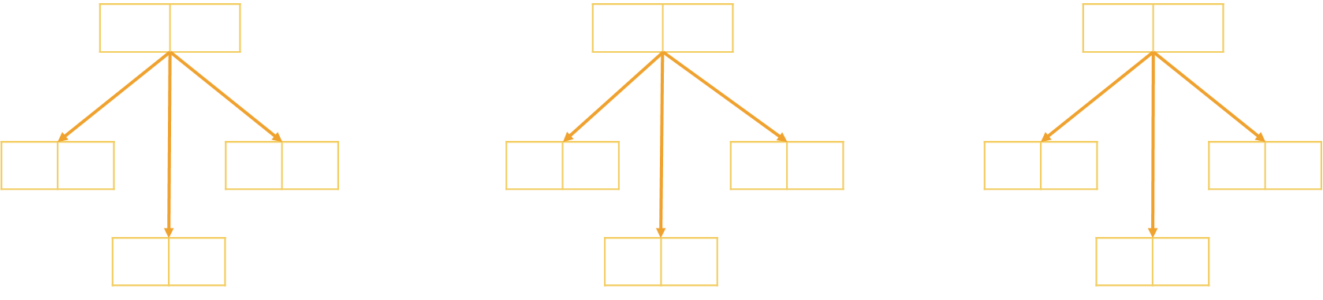
Problem: Generate Variations with Reps
Generates all possible variations of a given elements
You can pick an item multiple times
A A
A B
A C
B A B B
B C
C A
C B C C
A B C
2
<number>

Slide 56
Generating Permutations
public static void Gen(int index)
{
if (index >= k)
Console.WriteLine(string.Join(" ", variation));
else
{
for (int i = 0; i < n; i++)
{
variation[index] = elements[i];
Gen(index + 1);
}
}
elements = new int[n];
variation = new int[k]
Permute(0);
<number>

Slide 57
Variations with Reps: Iterative Algorithm
Generating the variations for n = 3 and k = 2
A | A
B | A
C | A
A | B
B | B
C | B
A | C
B | C
C | C
<number>

Slide 58
Variations with Reps: Iterative Algorithm
while (true)
{
Print(arr);
int index = k - 1;
while (index >= 0 && arr[index] == n-1)
index--;
if (index < 0)
break;
arr[index]++;
for (int i = index + 1; i < k; i++)
arr[i] = 0;
}
int n = 5;
int k = 3;
int[] arr = new int[k];
(0, 0, 0)
(0, 0, 1)
…
(4, 4, 2)
(4, 4, 3)
(4, 4, 4)
<number>

Slide 59

Variations Count
Order two from A, B, C and D in all possible ways
How many ways are there?
A | B | C | D
4
4
Multiply
^{k} =
16 different ways
<number>

Slide 60

Combinations

Slide 61





Combinations
Pick two to hang out
<number>

Slide 62
Combinations
<number>

Slide 63
Combinations
<number>

Slide 64
Combinations
<number>

Slide 65
Combinations
<number>

Slide 66
Combinations
<number>

Slide 67
Combinations
<number>

Slide 68
Combinations
<number>

Slide 69
Combinations
<number>

Slide 70
Combinations
<number>

Slide 71
Combinations
<number>

Slide 72
Combinations
Pick two form A, B and C
Order does not matter
A
B
C
A | B
A | C
B | C
<number>

Slide 73
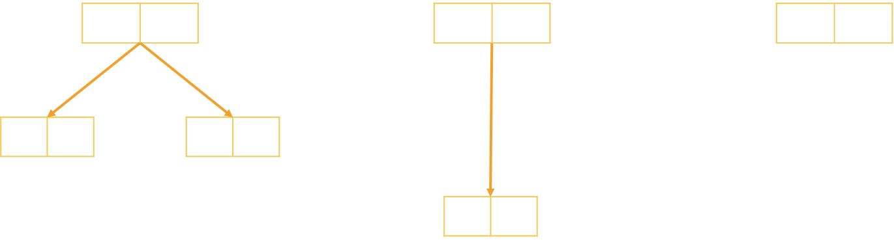
Problem: Generate Combinations
Generates all possible combinations from a given elements
You can pick each item only once
A B
A C
B C
A B C
2
<number>

Slide 74
Algorithm: Combinations without Repetition
Algorithm Comb(index, start)
Put the numbers i = start … n-1 at position index
Call Comb(index + 1, i + 1) to generate the rest of the array
Comb(0, start)
Comb(1, start)
Comb(k, start)
Print();
Stop!
i | x | x | x | x | x | x
→
y | i | x | x | x | x | x
…
Comb(1, i+1)
Comb(2, i+1)
<number>

Slide 75
Combinations without Repetition
void Comb(int index, int start)
{
if (index >= k)
{
PrintCombinations();
}
else
for (int i = start; i < n; i++)
{
arr[index] = i;
Comb(index + 1, i + 1);
}
}
int k = 3;
int n = 5;
int[] arr = new int[k];
Comb(0, 0);
<number>

Slide 76

Combinations Count
Pick two from A, B, C and D in all possible ways, order does not matter
How many ways are there?
A | B | C | D
4
3
Variations n = 4, k = 2
2
1
Permutations of n = 2
=
6 different ways
<number>

Slide 77
Algorithm: Combinations with Repetition
Algorithm Comb(index, start)
Put the numbers i = start … n-1 at position index
Call Comb(index + 1, i) to generate the rest of the array
CombRep(0, start)
CombRep(1, start)
CombRep(k, start)
Print();
Stop!
i | x | x | x | x | x | x
→
y | i | x | x | x | x | x
…
CombRep(1, i)
CombRep(2, i)
<number>

Slide 78
Generate Combinations with Repetition
void Comb(int index, int start)
{
if (index >= k)
{
PrintCombinations();
}
else
for (int i = start; i < n; i++)
{
arr[index] = i;
Comb(index + 1, i);
}
}
int k = 3;
int n = 4;
int[] arr = new int[k];
Comb(0, 0);
<number>

Slide 79
Variations and Combinations
Live Exercises in Class (Lab)

Slide 80


N Choose K Count

Slide 81

Problem: Combinations Count
How many combinations are there for n = 16, k = 15
Solution:
How many ways to pick 15 items?
Divide by the number of ways in which you can arrange 15 numbers
Possible combinations → 16
$C_{n}^{k}=\left(\begin{aligned}n \\ k\end{aligned}\right)=\frac{n!}{\left(n−k\right)!k!}$
16 * 15 * 14 * … * 2
15 * 14 * 13 * … * 1
<number>

Slide 82
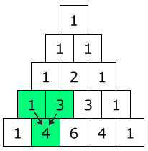

Pascal's Triangle
Each node → how many ways are there to reach it?
Quickly find N choose K count
Go down to row n (the top row is 0)
Move along k places to the right
The value there is your answer
$C_{n}^{k}=\left(\begin{aligned}n \\ k\end{aligned}\right)=\frac{n!}{\left(n−k\right)!k!}$
<number>

Slide 83
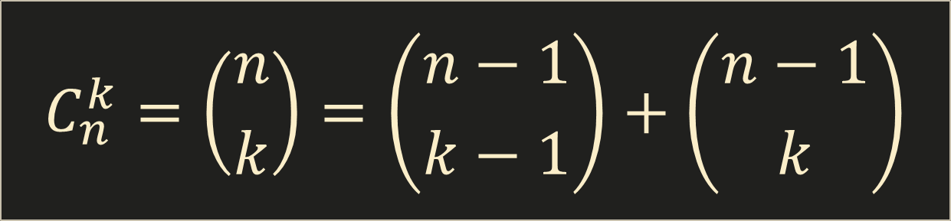
Binomial Coefficients: Calculation
$C_{n}^{k}=\left(\begin{aligned}n \\ k\end{aligned}\right)=\left(\begin{aligned}n−1 \\ k−1\end{aligned}\right)+\left(\begin{aligned}n−1 \\ k\end{aligned}\right)$
Base cases:
if k > n → 0
if k == 0 → 1
if k == n → 1
<number>

Slide 84
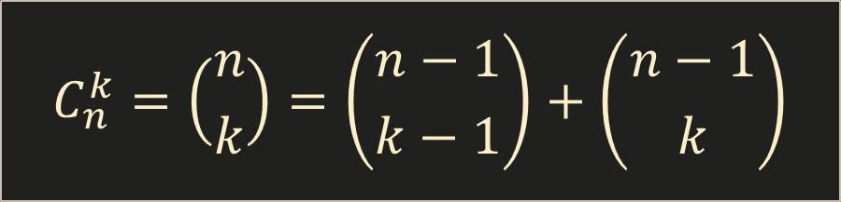

Binomial Coefficients: Calculation
decimal Binom(int n, int k)
{
if (k > n)
return 0;
if (k == 0 || k == n)
return 1;
return Binom(n - 1, k - 1) + Binom(n - 1, k);
}
$C_{n}^{k}=\left(\begin{aligned}n \\ k\end{aligned}\right)=\left(\begin{aligned}n−1 \\ k−1\end{aligned}\right)+\left(\begin{aligned}n−1 \\ k\end{aligned}\right)$
This is slow (stay tuned for DP)
<number>

Slide 85

Summary
Permutations – Ways to order n elements
Variations – Ways to order k of n elements
Combinations – Ways to choose k of n elements
Pascal's Triangle
Binomial Coefficients () –
<number>

